Slide 1

Object Oriented Programming

Slide 2
Object Oriented Programming (using C++)
WEEK 1

Slide 3
Course Outline
This course will offer students a thorough theoretical foundation of object-oriented programming as well as practical abilities. The major goal of the course is to prepare students to handle complicated programming challenges by utilizing the object-oriented programming paradigm to ease the design and implementation process.

Slide 4
Course Learning Outcomes
1. Understand principles of object oriented paradigm.
2. Identify the objects & their relationships to build object oriented solution
3. Model a solution for a given problem using object oriented principles
4. Examine an object oriented solution

Slide 5
Assessment Methods
Assignments : How many ?
Quizzes : How many ? Mostly unannounced
Home Tasks : Random
Class Participation : Multiple factors !
Project : Heavy Weight
Sessional Exams : Obvious
Final Exam : Obvious

Slide 6
BOOKS
"Programming: Principles and Practice Using C++" by Bjarne Stroustrup, the creator of C++. This book is excellent for understanding the principles and practice of C++, including OOP concepts.
"C++ Primer Plus" by Stephen Prata. This book provides a comprehensive introduction to C++ and includes coverage of OOP concepts.
"Object-Oriented Programming in C++" by Robert Lafore. This book provides a clear and concise introduction to OOP in C++.
C++ How to Program, by Paul Deitel and Harvey Deitel

Slide 7
VIDEOS
Any playlist that makes you understand, better read book.

Slide 8
Web resource
cplusplus.com/doc/tutorial/

Slide 9
REMINDER !
No late coming
No short attendance
No use of mobile
No ill manners (Persistent talking, whispering or any disruptive attitude)
No plagiarism
No chewing of bubble gums.
No relaxation in submission deadlines.

Slide 10
Idea behind oop
OOP motivation from biology and scala language.

Slide 11
IDE
IDE (Integrated Development Environment) is a software application that typically consists of a code editor, a compiler, a debugger, and a graphical user interface (GUI) builder.

Slide 12
What is indentation ?

Slide 13
What is OOP
OOP is a way of writing code by grouping similar things together, making it easier to manage and understand. It’s like organizing your toys by putting all the cars together, all the dolls together, and so on.

Slide 14
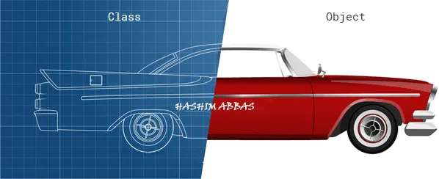

Slide 15
C++ improves on many of C’s features and provides object-oriented-programming (OOP) capabilities that increase software productivity, quality and reusability.
C++ was developed by Bjarne Stroustrup at Bell Laboratories and was originally called “C with classes.” The name C++ includes C’s increment operator (++) to indicate that C++ is an enhanced version of C.
Extension is .cpp

Slide 16
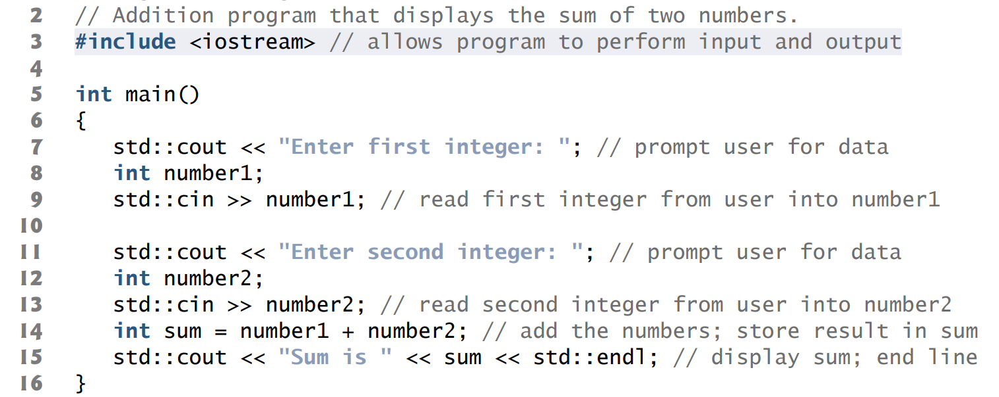

Slide 17
input/output stream header file <iostream>

